Slide 1
SIEM

Slide 2

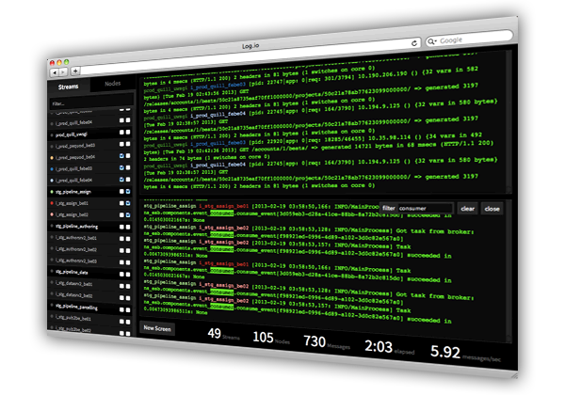
SIEM
Security Information and Event Management
Real-time security alerts generated by devices
Data aggregation
Data correlation
Link diverse data types
Build better picture of events
Log storage
Forensic analysis

Slide 3
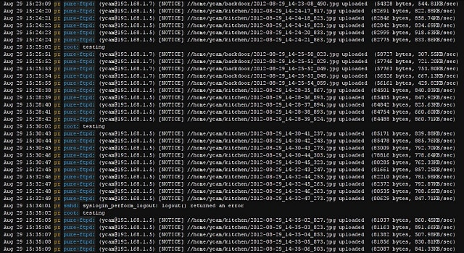

Syslog
Standard for event logging
Usually a central logging receiver
Eats up gobs of disk space
WORM drive technology
Write One Read Many
DVD-R, WORM hard drives
Save logs for later review

Slide 4
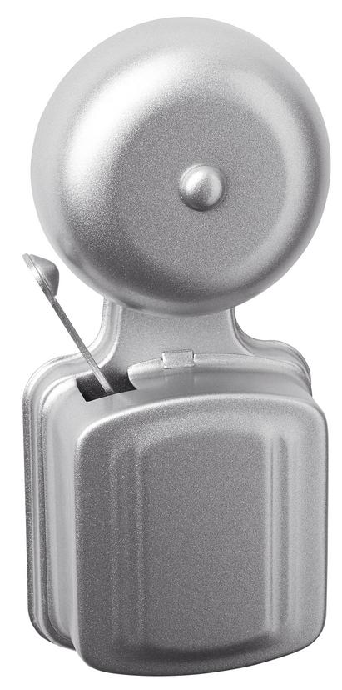
Event de-duplication
Event storms
Multiple failures at once
Filter events
Identify and zero in on real problems
Flapping
Service is up, down, up, down (like flapping in the wind)
Suppression meaningless errors/alerts

Slide 5
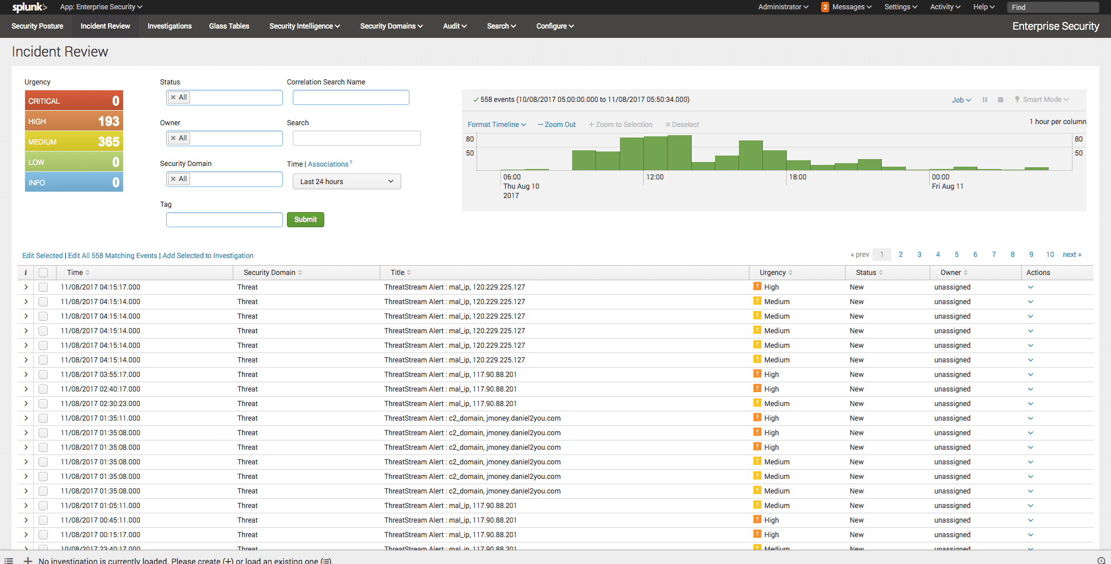
SIEM Security reports
Splunk

Slide 6
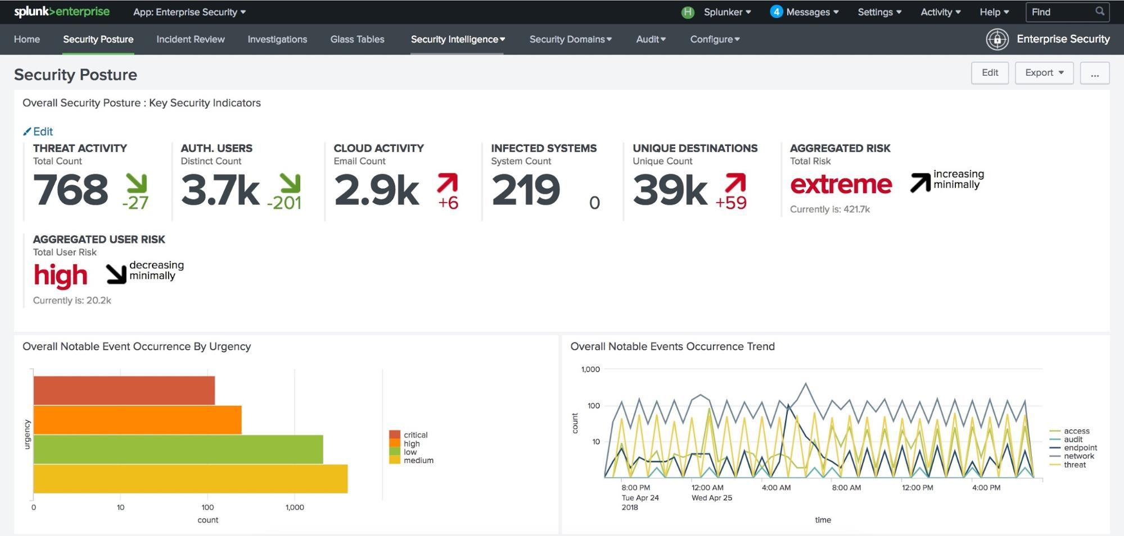
SIEM dashboard
Splunk

Slide 7
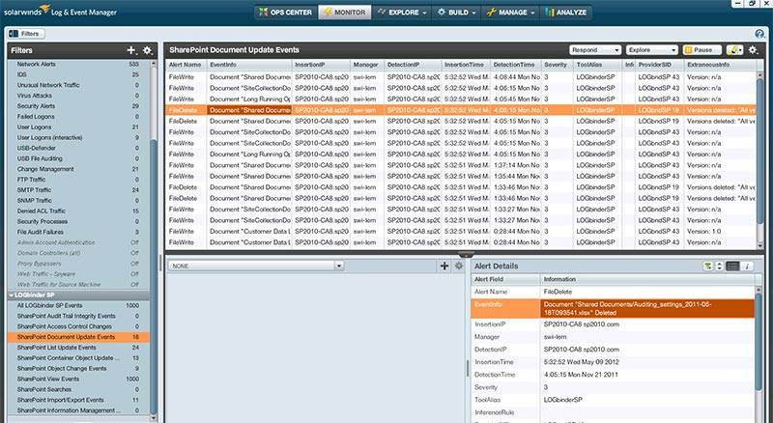
SIEM Security reports
Solarwinds

Slide 8
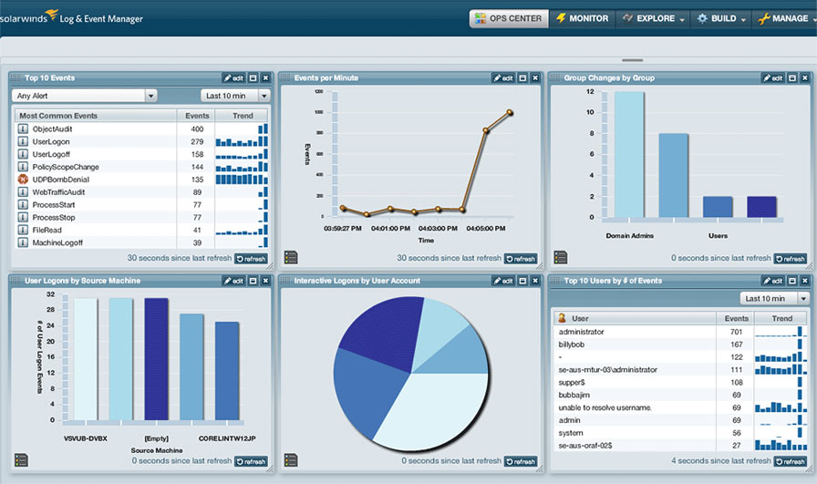
SIEM dashboard
Solarwinds

